Slide 1
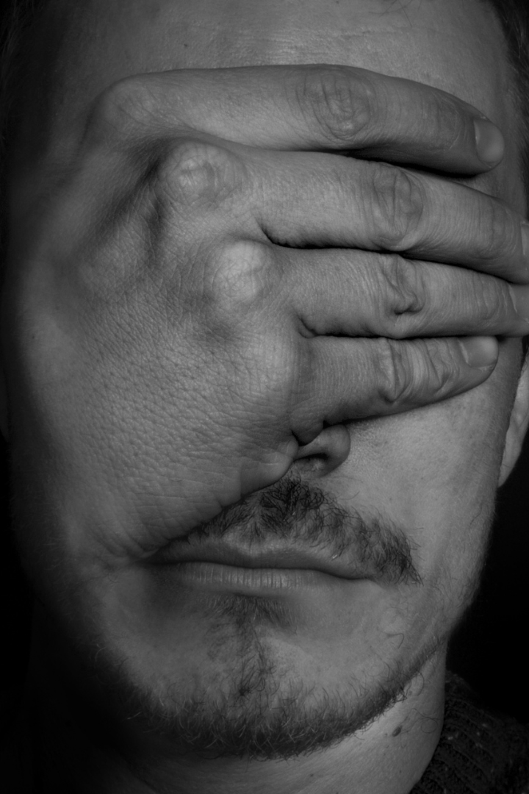
CSE 431
Sound of Silence: Transforming Visuals into Audio For the Blind
Explore how the power of NLP can bridge the accessibility gap for visually impaired individuals, transforming images into immersive audio experiences
RA: EHSANUR RAHMAN RHYTHM
ST: FARAH BINTA HAQUE
Presented By:
Team 18
Isratul Hasan 20301072
Maliha Mehejabin 20301264 Tahsin Ashrafee Susmit 20301088

Slide 2

Introduction
Discover the significance of using NLP to convert images into audio for the visually impaired community. Explore existing solutions and their limitations.

Slide 3

Literature Review
Image-to-Audio Conversion
NLP Techniques
Identifying Gaps
Review the application of NLP techniques in generating natural language descriptions of visual content.
Identify gaps and challenges in the existing literature to inform further advancements in the field.
Explore existing research on converting visuals into audio to aid visually impaired individuals.

Slide 4
Methodology
Dataset
NLP Techniques
Audio Generation Process
Define the types of images used in the study, ranging from everyday objects to complex scenes.
Specify the NLP models and algorithms employed to generate detailed textual descriptions of images.
Explain the step-by-step process of converting textual descriptions into immersive audio experiences.

Slide 5
Image Processing
1
Information Extraction
Discuss methods for extracting relevant information from images for accurate audio descriptions.
2
Computer Vision Techniques
Explore the potential of computer vision techniques to enhance feature extraction from images.

Slide 6

Natural Language Processing
1
Coherent Descriptions
Explain the NLP models used for generating contextually relevant and coherent audio descriptions.
2
Training Process
Discuss the training and fine-tuning process to optimize the quality of textual descriptions.

Slide 7

Audio Generation
1
Text-to-Speech Conversion
Explore the process of converting textual descriptions into audio, considering voice synthesis, intonation, and pacing.
2
Immersive Experience
Create an immersive audio experience by leveraging audio effects to enhance the realism of the auditory experience.

Slide 8

Evaluation
1
Evaluation Metrics
Define robust metrics to evaluate the effectiveness and accuracy of the image-to-audio conversion system.
2
Comparative Analysis
Compare the results of the developed system with existing solutions and benchmarks in the field.
3
User Feedback
Present feedback from visually impaired individuals who have experienced the audio conversion system.

Slide 9

Challenges and Limitations
Development Challenges
Discuss the challenges faced during the development of the image-to-audio conversion system.
Potential Limitations
Address potential limitations of the approach, including accuracy, scalability, and resource requirements.

Slide 10

Conclusion
1
Summary of Findings
Summarize the key findings and advancements achieved through the image-to-audio conversion system.
2
Impact on Accessibility
Emphasize the transformative impact of the system on enhancing accessibility for visually impaired individuals.

